Slide 1


3RD EDITION
Armenia Large Language Models Summer School 2026
AUGUST 3–7, 2026 | AI9 STARTUP CAMPUS, YEREVAN
Bringing the forefront of LLM research to Armenia.

Slide 2







ALIGNMENT WITH ARMENIA'S AI DEVELOPMENT
OBJECTIVE & SCOPE
TARGETED TOPICS
This summer school is in line with current developments in Armenia: compute infrastructure by Firebird, Eleveight and YSU, and policies. Armenia aims to grow the number of strong world-class AI researchers by 2032 to reach 200. This school supports this goal by empowering existing researchers and students.
Pre-training: Foundations of LLMs + Vision-Language Models (VLMs).
SFT & RL: Supervised Fine-Tuning and Reinforcement Learning.
Agents & Tools: Test-time compute, autonomous agents, and tool usage.
The curriculum will cover a range of both core and specialized topics in LLMs, ensuring participants gain both theoretical depth and practical expertise.
Each offline participant gets 1 GPU for practical sessions.
Advanced Systems: Context management and VLA / Robotics.
These topics are essential additions to the university curriculum, providing the flexibility needed to reflect the fast-paced evolution of global AI research.

Slide 3



BRIDGING THE GAP: GLOBAL RESEARCH & LOCAL INNOVATION
THE NEED
FUNDING GOALS
Targeting 80 In-Person Participants
90% Student Fee Waivers
A balanced cohort of 40 industry professionals and 40 students to foster cross-sector collaboration.
Directly subsidizing the participation of Armenian university students to build the local talent pool.
Removing Financial Barriers
Researcher Travel Costs
High-quality AI training costs are often prohibitive for local students. We ensure merit-based access.
Covering travel for global experts to come to Armenia for teaching.
NEEDED BUDGET: 15,000 USD

Slide 4
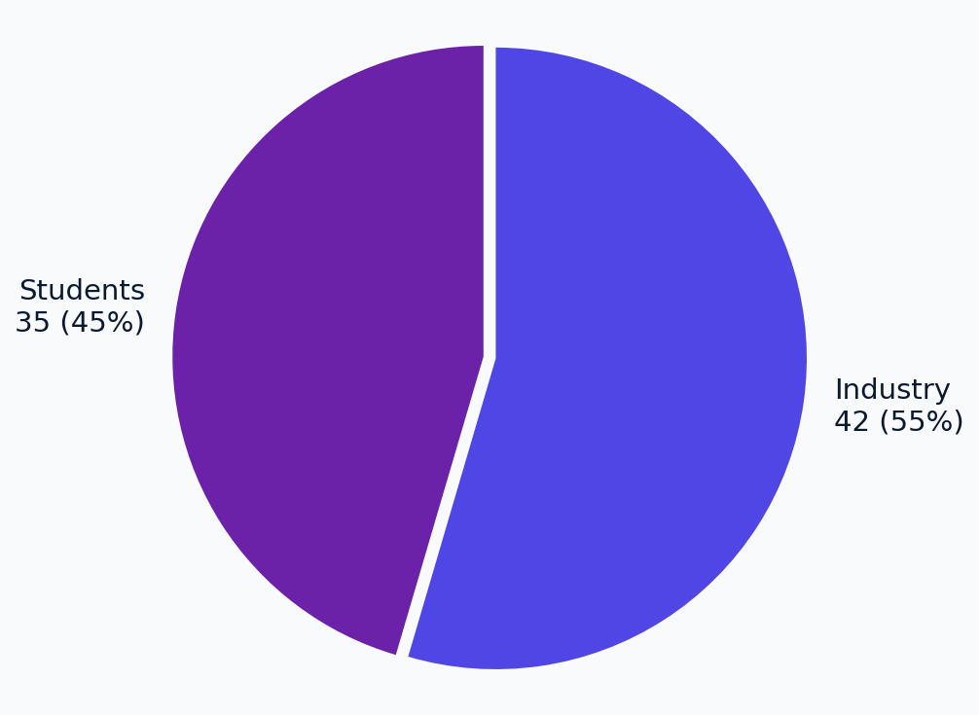
PROVEN IMPACT: GROWING DEMAND FOR AI EDUCATION
2025 Participation Breakdown
200+
APPLICATIONS IN 2025
115+
TOTAL PARTICIPANTS
Our track record demonstrates a significant and growing interest in high-level AI education within Armenia and the region. The summer school has become a competitive hub for talent training. 2025 Participation: 35 students (90% with financial aid), 42 industry professionals (paid 100,000 AMD). Participants from: Italy, USA, Russia, Iran, India, Armenia. 2025 Participation: 35 students (90% with financial aid), 42 industry professionals (paid 100,000 AMD). Participants from: Italy, USA, Russia, Iran, India, Armenia.

Slide 5



WORLD-CLASS AI EXPERTISE: FEATURED SPEAKERS
2024 EDITION
2025 EDITION
Armen Aghajanyan
Armen Aghajanyan
Perceptron AI, ex-Meta
Perceptron AI, ex-Meta
Erik Arakelyan
Alexandre Drouin
UCPH, NVIDIA
Université Laval (MILA) / ServiceNow Research
Hrayr Harutyunyan
Gauthier Gidel
Google Research
Université de Montréal (MILA)
Eugene Bagdasaryan
Michael Noukhovitch
Google / UMass Amherst
Université de Montréal (MILA)
Karen Hambardzumyan
Nouha Dziri
UCL
Allen Institute for AI (AI2)
Jonathan May
USC
Jiao Sun
USC

Slide 6
THE ORGANIZING TEAM: LEADING THE VISION
Our organizing committee brings together leading researchers from top global institutions to drive AI innovation in Armenia.
Armen Aghajanyan
Erik Arakelyan
Aram Galstyan
PERCEPTRON AI
NVIDIA
USC / AMAZON
Hrant Khachatrian
Perouz Taslakian
YEREVANN
SERVICENOW RESEARCH

Slide 7








OUR PARTNERS AND SUPPORTERS OF PREVIOUS EDITIONS
We are grateful for the continued support of our partners in building Armenia's AI ecosystem. Armenia Fund: speaker travel & accommodation for 2025. Nebius: compute infrastructure partner. AI9 & AUA: venue partners. Arcs AI & ASOF: facilitated Armenia Fund and Summer School collaboration. Picsart: travel & speaker accommodation for 2024. Profound Academy: platform for entrance exam. Collaborations: Martha Hovhannesian—Legal aspects of LLMs (post-school talk). Perouz Taslakian—AI Agents lecture at Yandex Hall. Picsart—office tour for participants. Armenia Fund: speaker travel & accommodation for 2025. Nebius: compute infrastructure partner. AI9 & AUA: venue partners. Arcs AI & ASOF: facilitated Armenia Fund and Summer School collaboration. Picsart: travel & speaker accommodation for 2024. Profound Academy: platform for entrance exam.

Slide 8
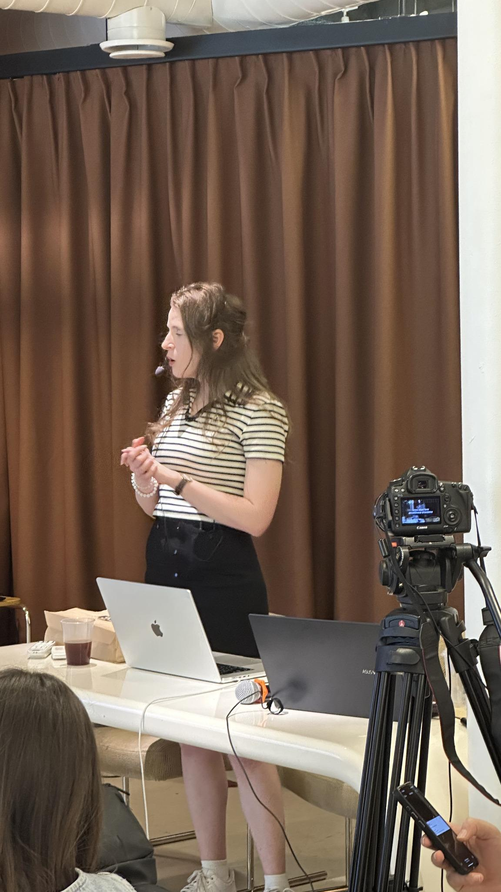
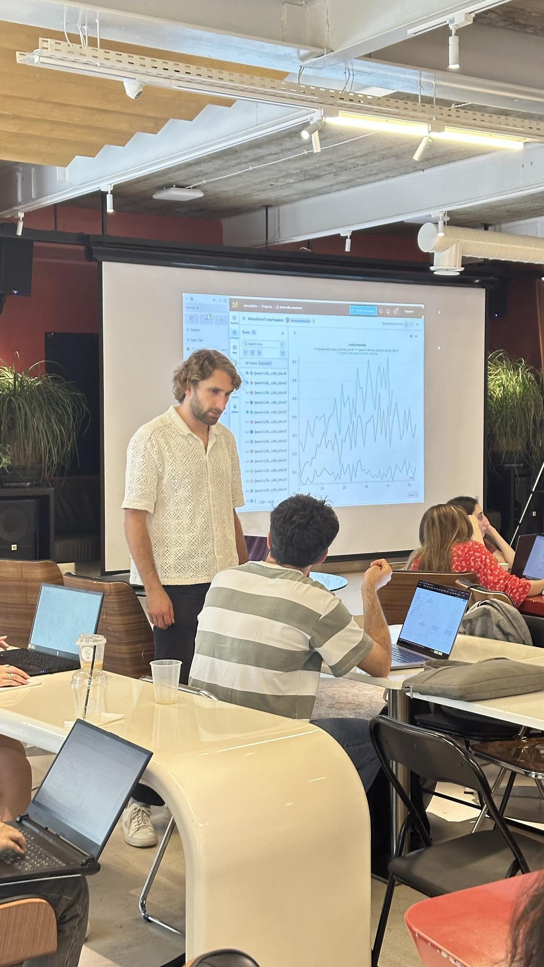


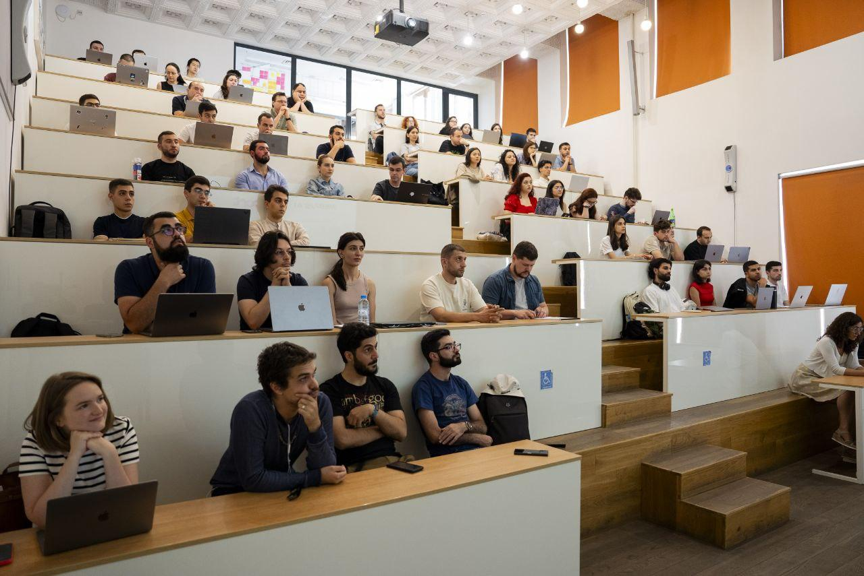
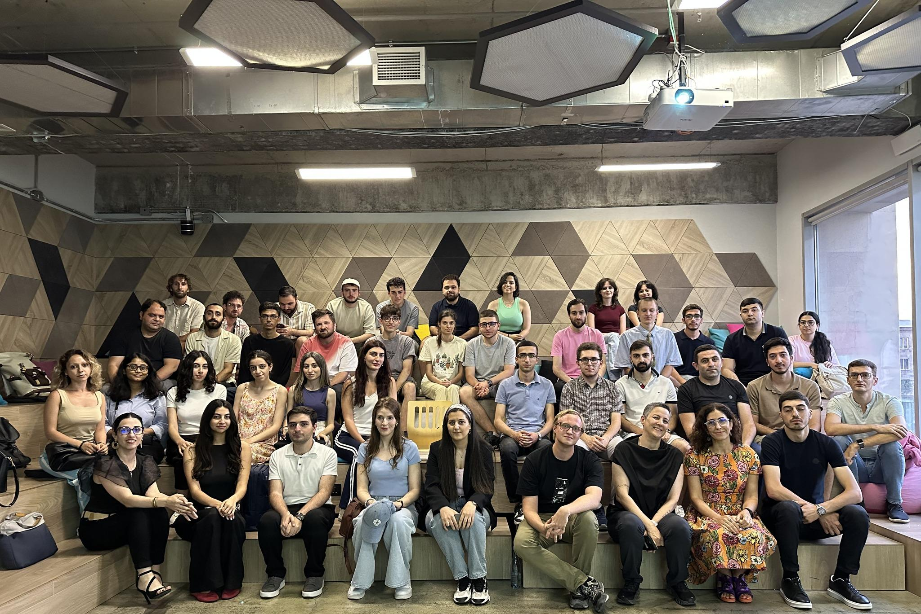
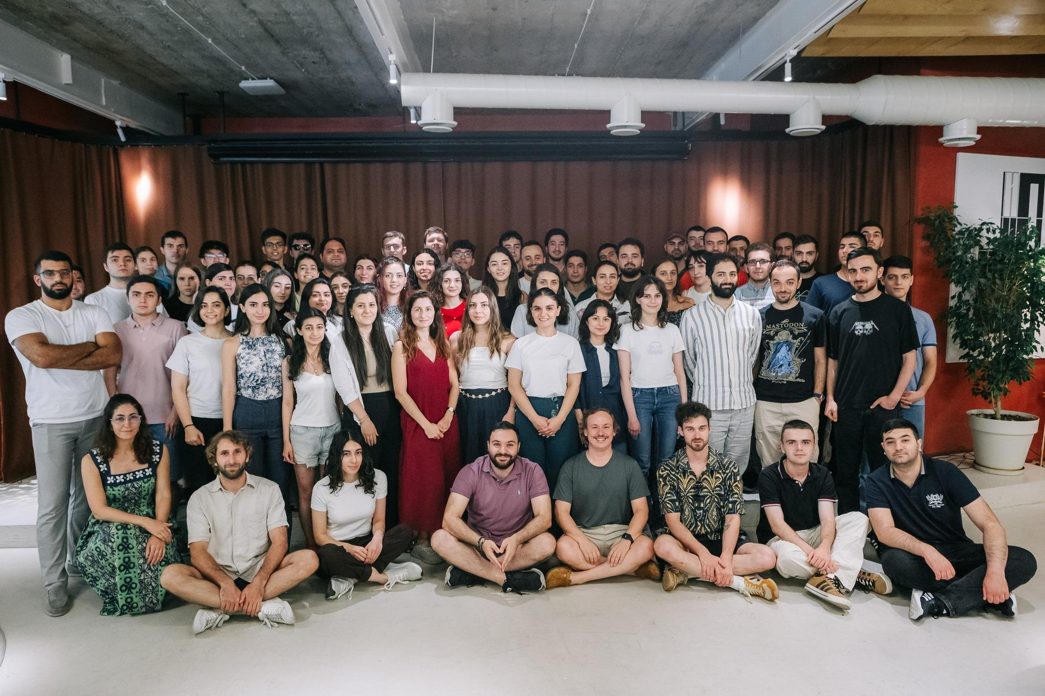
MEDIA HIGHLIGHTS: CAPTURING THE MOMENTUM
Press & Podcasts
Video & Social
Gortsarar Aliq
2025 Recordings Playlist
News.am Coverage
Բա իմացար
ArmPublicTV
LinkedIn Community Update
EVN Report Podcast
Instagram Highlights
iTel Tech News
Gortsarar Aliq

Slide 9
NEEDED BUDGET: 15,000 USD
RESEARCHER TRAVEL
STUDENT FINANCIAL AID
Covers travel and accommodation for
5 world-class researchers from the US, Canada, and Europe to teach at the summer school.
Covers ticket and accommodation
Providing up to 90% financial aid for Armenian University students to ensure merit-based access to high-quality AI education.
Last year budget: ~15K USD for speaker travel & accommodation in Yerevan; 11K USD for online accommodation, logistics, coffee breaks, networking. Financial aid: 35 students (90%); 42 industry professionals paid 100,000 AMD. 80 GPUs for school (~60K value); 1 GPU per student. Speakers: no honorarium, travel only. Venue: AI9 contribution. Last year budget: ~15K USD for speaker travel & accommodation in Yerevan; 11K USD for online accommodation, logistics, coffee breaks, networking. Financial aid: 35 students (90%); 42 industry professionals paid 100,000 AMD. 80 GPUs for school (~60K value); 1 GPU per student. Speakers: no honorarium, travel only. Venue: AI9 contribution. Your support directly enables global expertise to empower local talent in Armenia.

Slide 10



PARTNER WITH US TO SHAPE THE FUTURE OF AI
Talent Pool Growth
Brand Visibility
Global Networking
Directly contribute to the growth of the Armenian AI talent pool by supporting
merit-based education for top students.
Gain prominent visibility among 200+ high-caliber AI applicants, industry leaders, and global researchers.
Connect with world-class researchers from top institutions and local innovators in the Armenian tech ecosystem.
GET INVOLVED
VENUE SPONSOR
armeniallm@gmail.com
AI9 STARTUP CAMPUS
Join us for the 2026 Edition in Yerevan.
9 Isahakyan St, Yerevan, Armenia

